Slide 1
Mark Iscoe, MD, MHS
UVA Informatics Elective
January 29, 2026

Slide 2
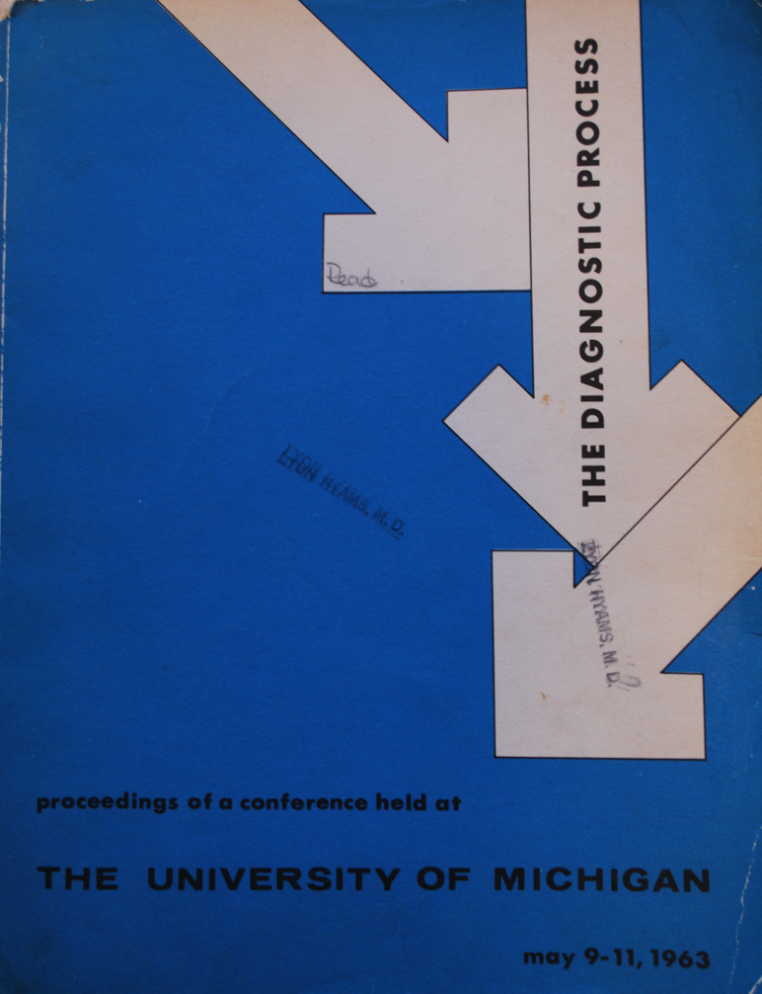
About me
From Washington, DC
BA, Yale College (History)
Writer at American Museum of Natural History
MD, Johns Hopkins
Emergency Medicine residency, NYU/Bellevue
MHS/CI fellowship, Yale
Assistant Professor of Biomedical Informatics and Data Science & Emergency Medicine

Slide 3
Areas of research
Big picture:
Diagnostic process
Clinical reasoning
Care for older adults
Substance use disorders
Methods:
EHR audit log analysis
Real-world data
Predictive modeling
Natural language processing
Clinical decision support

Slide 4
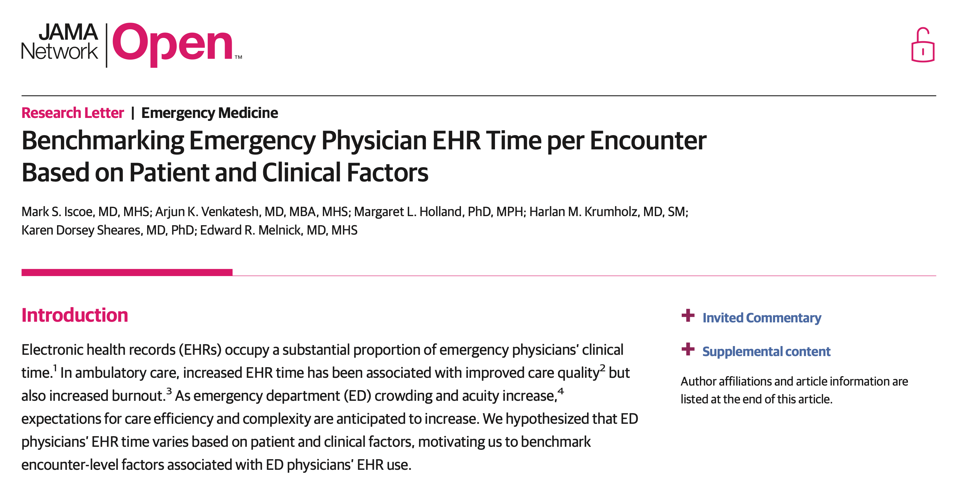

Slide 5
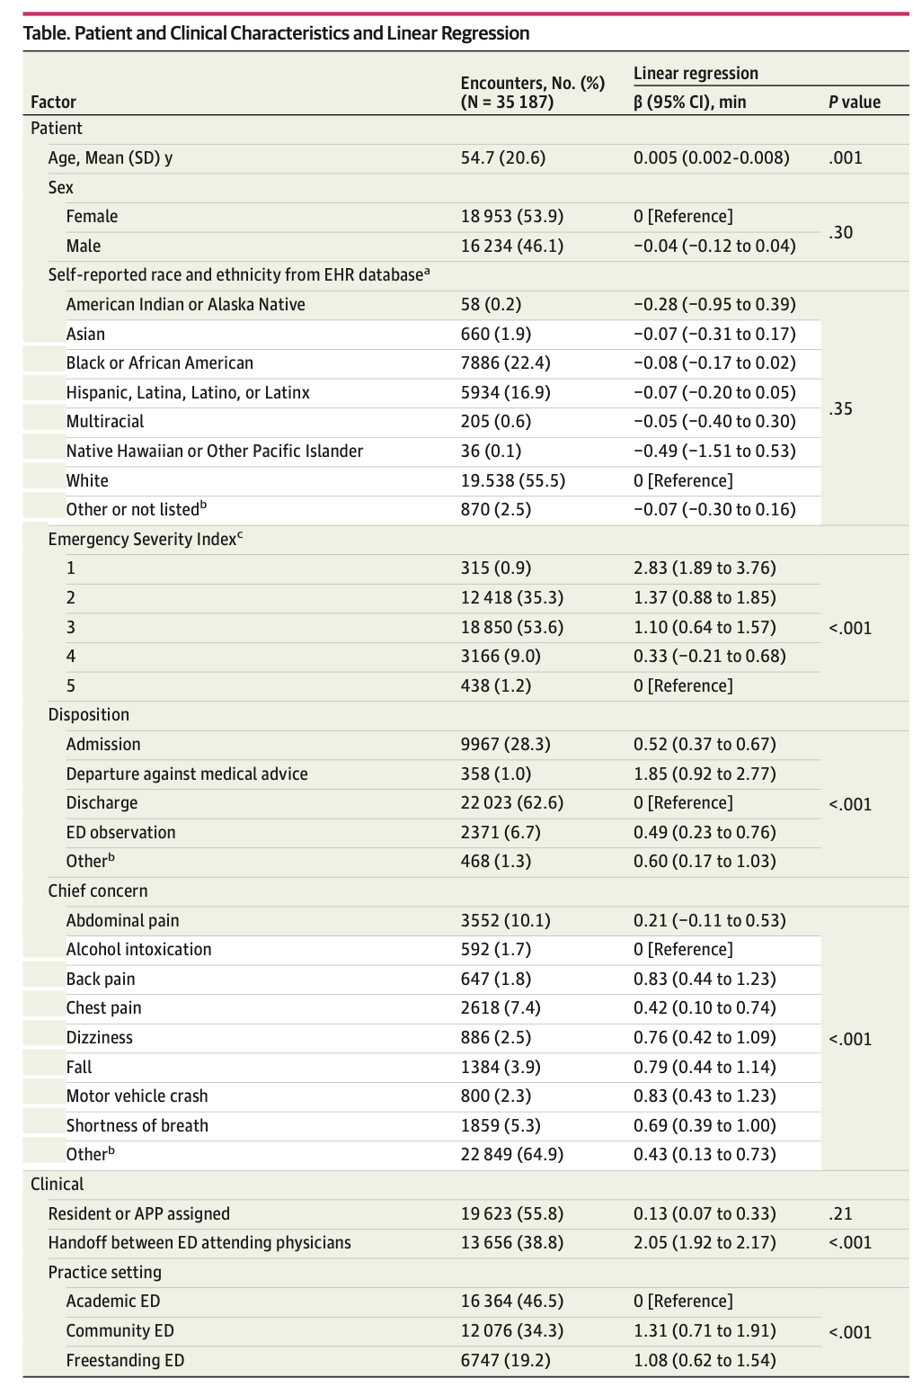
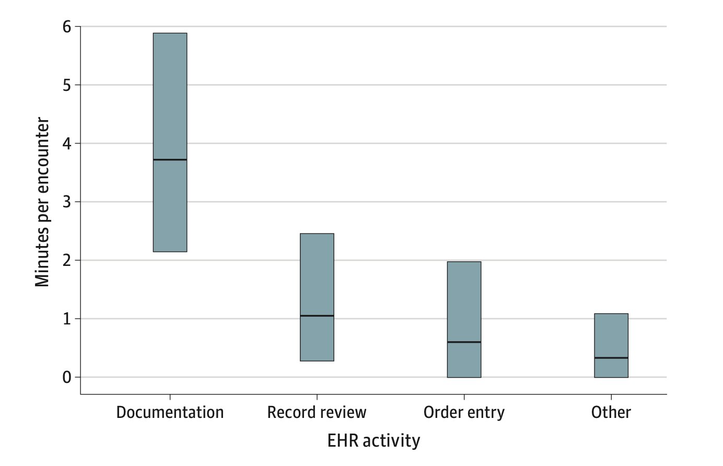

Slide 6
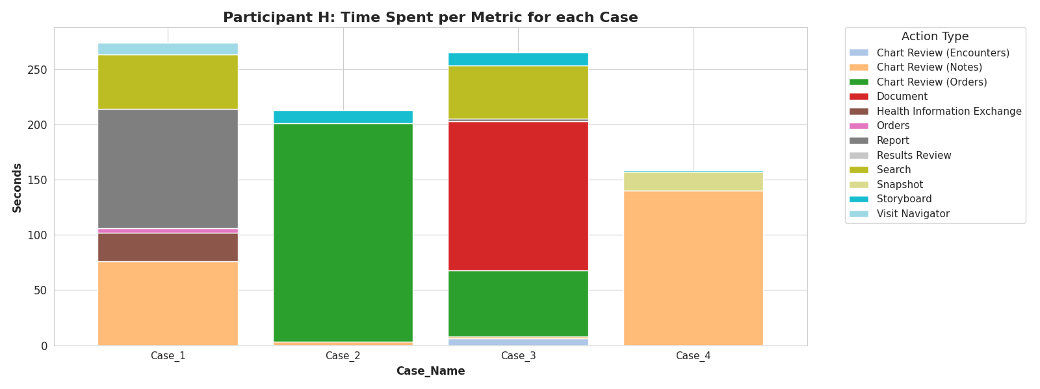
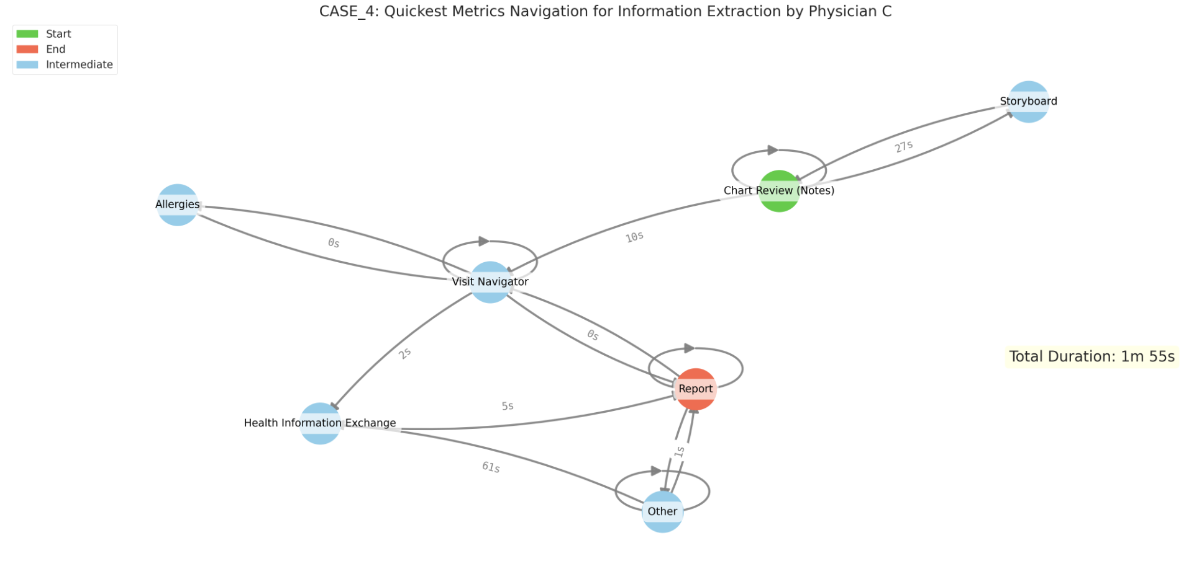

Slide 7
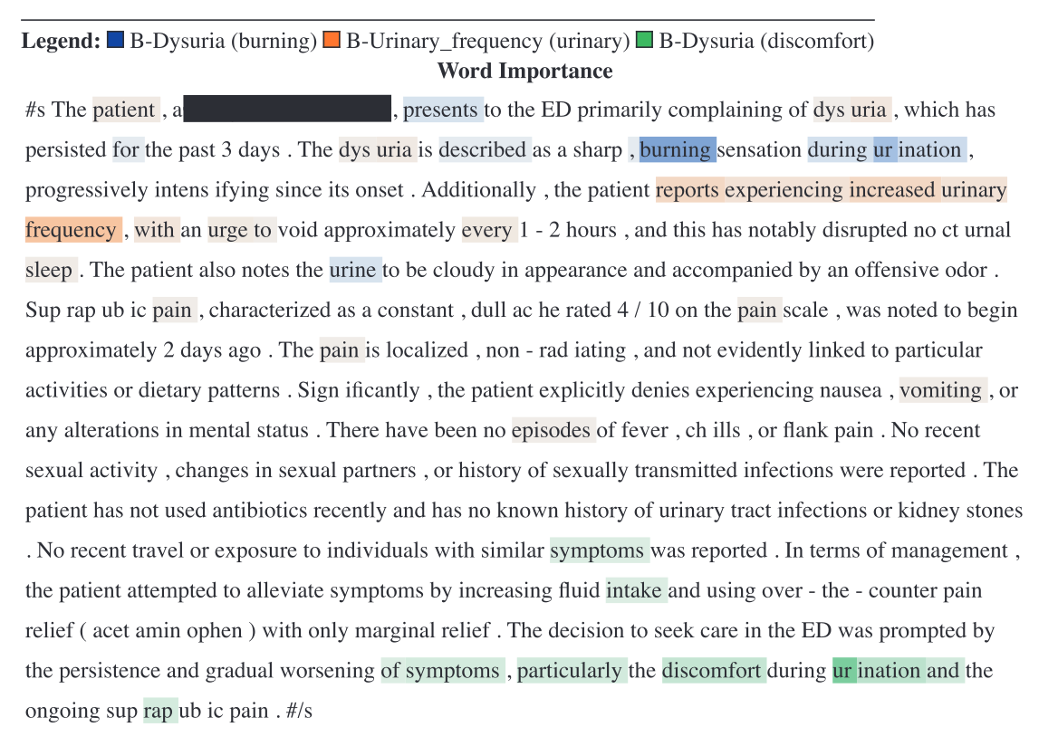
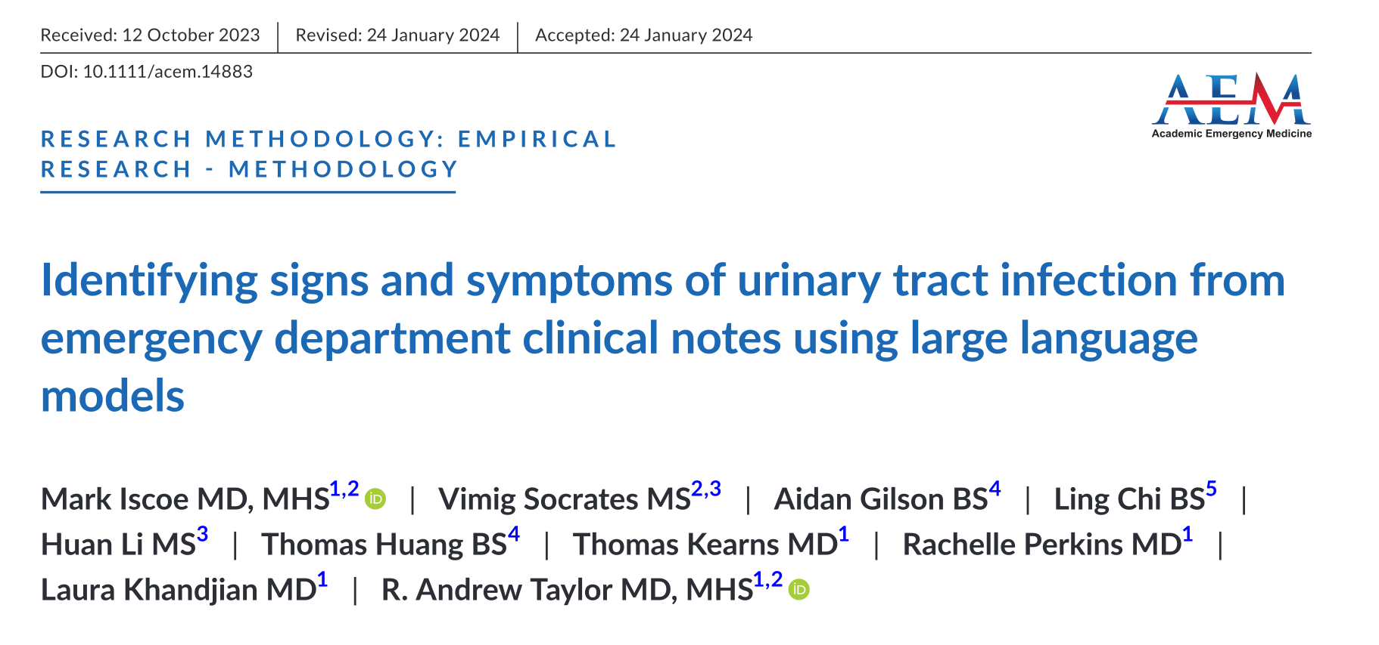

Slide 8
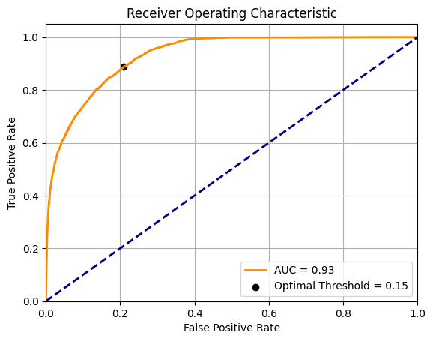
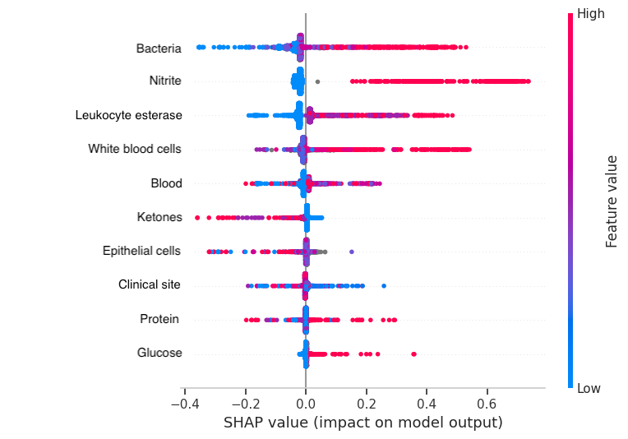

Slide 10
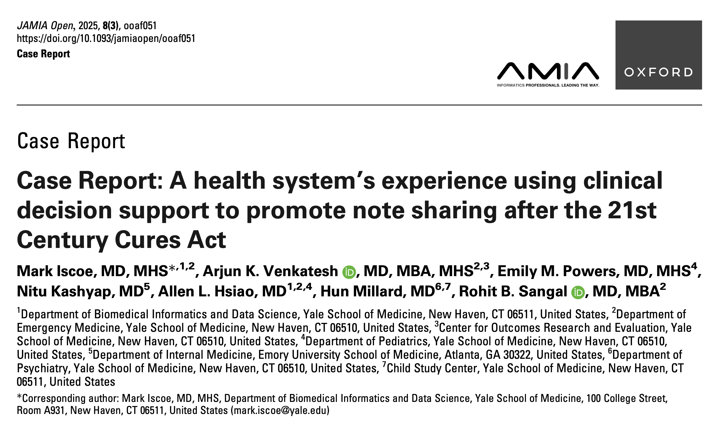

Slide 11
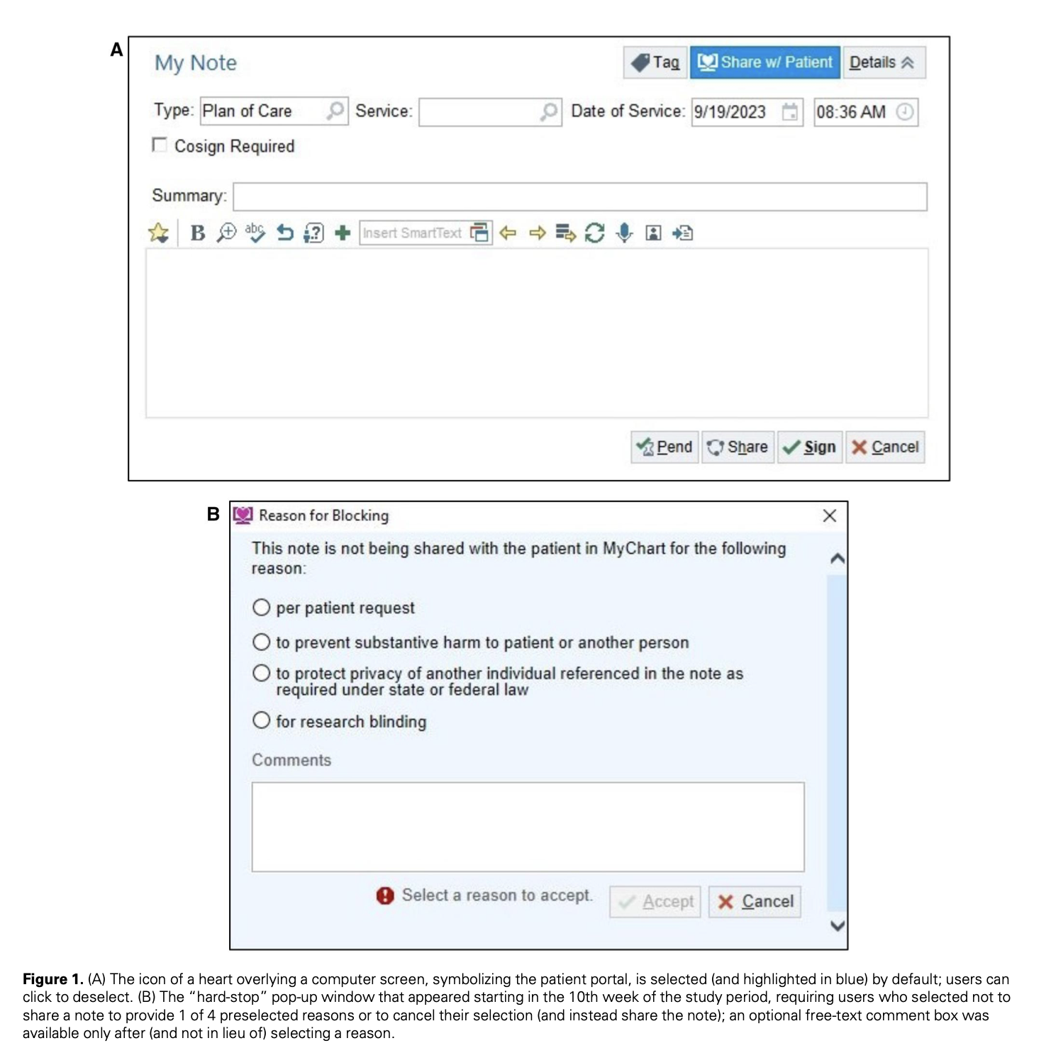

Slide 12
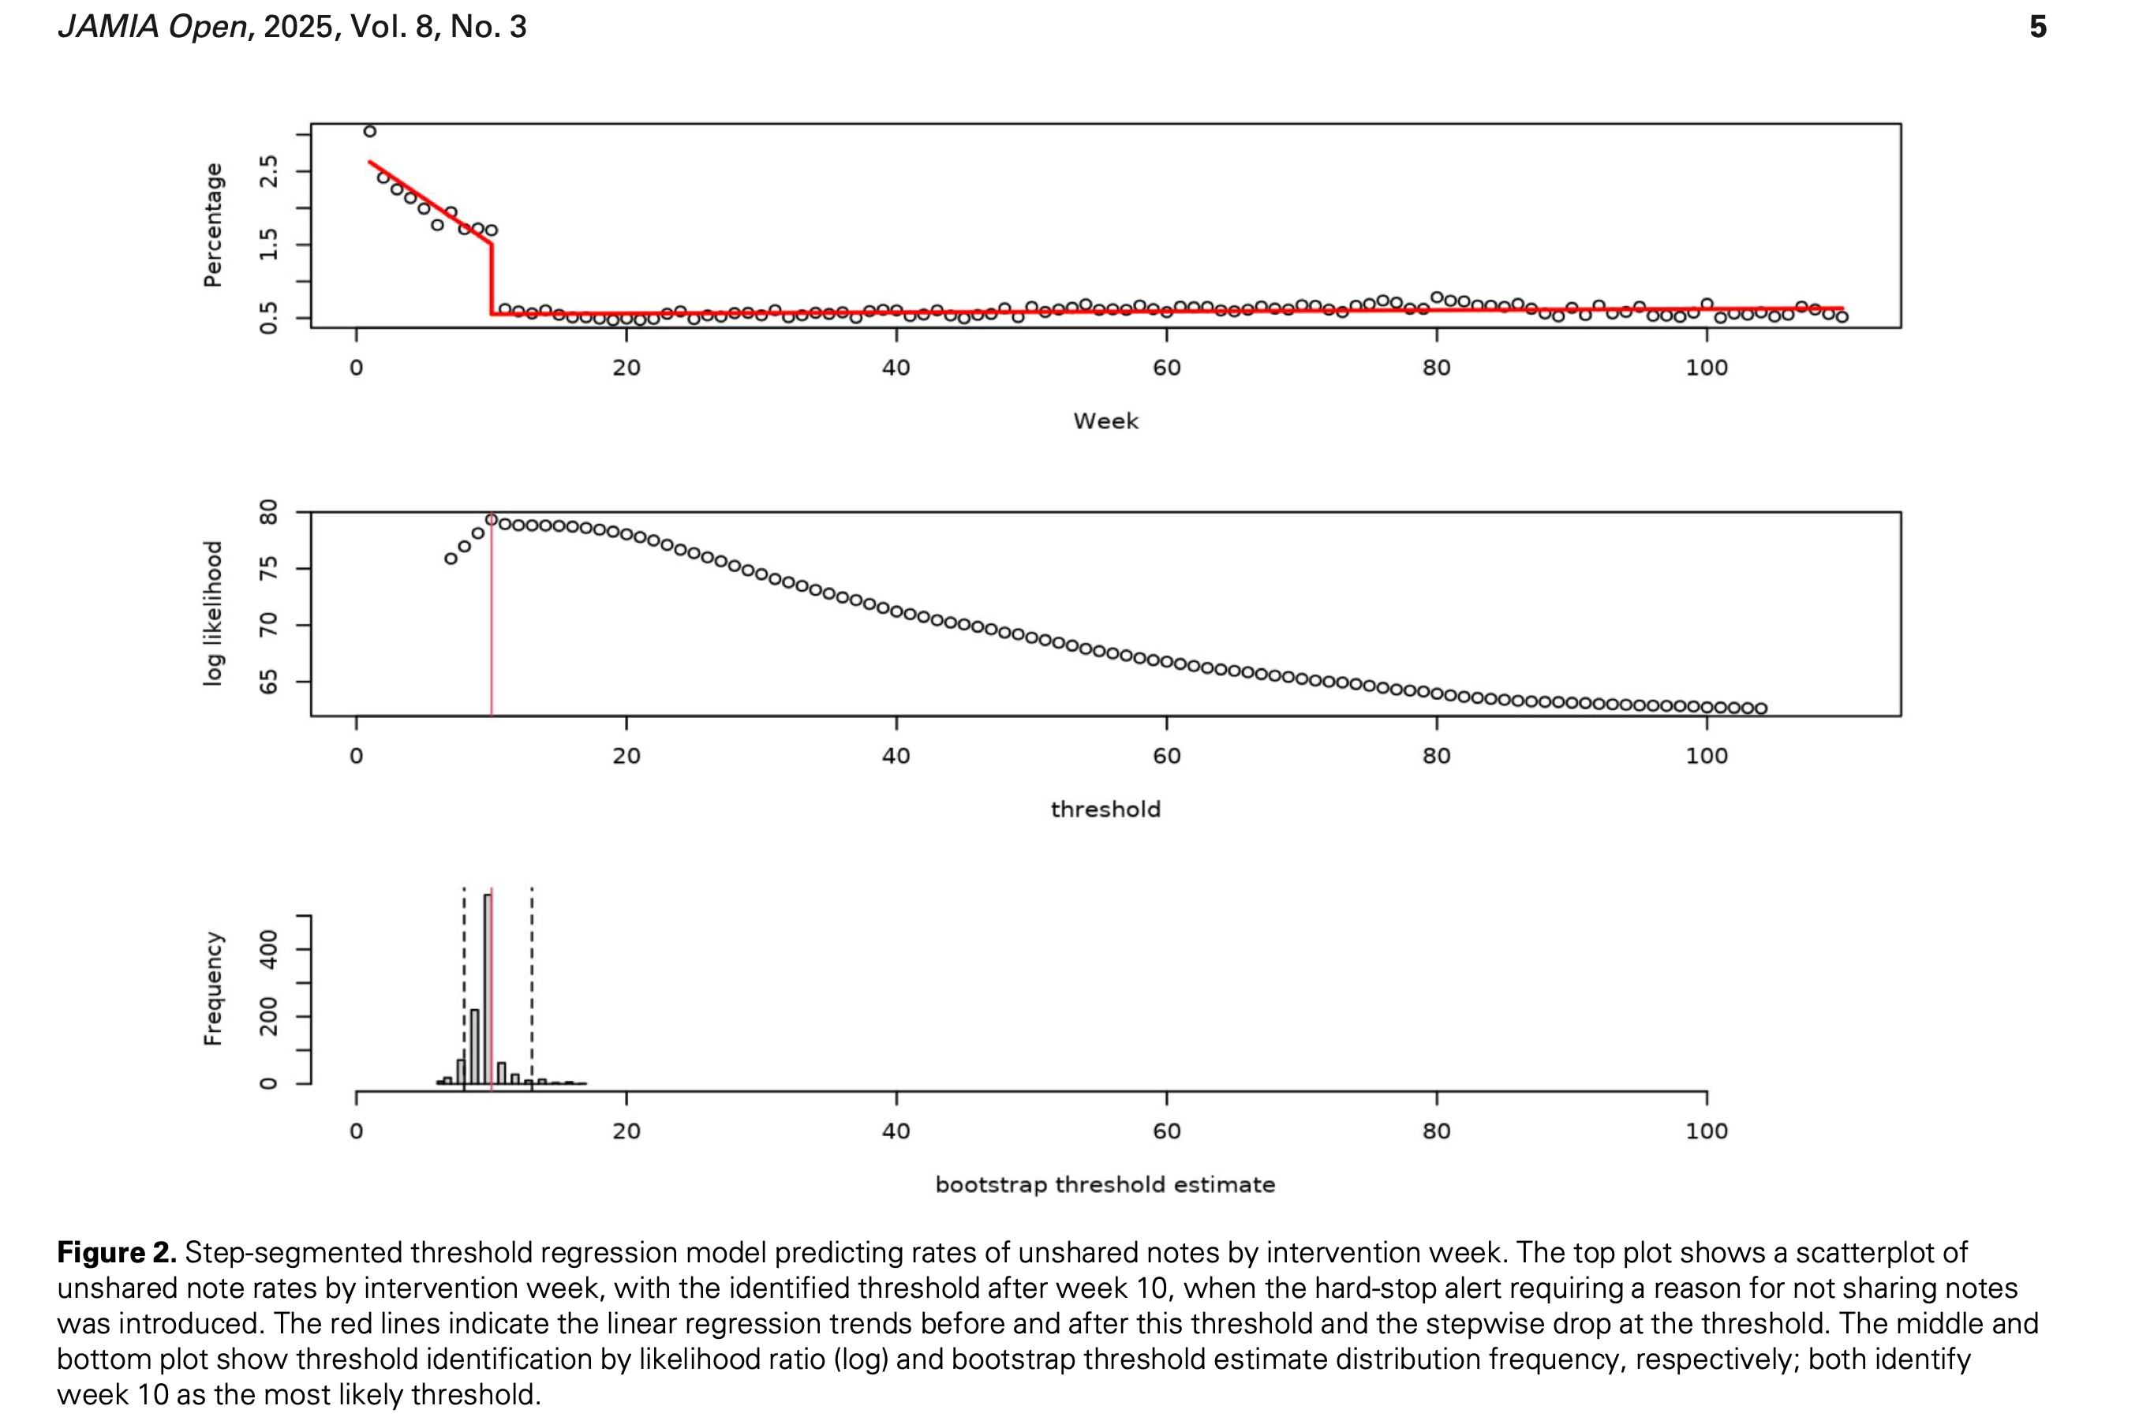

Slide 13
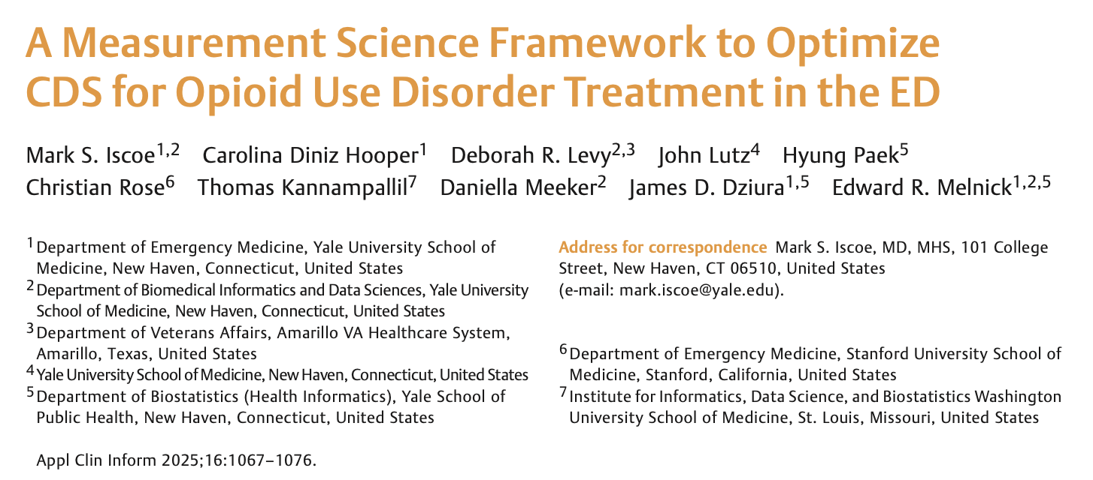

Slide 14
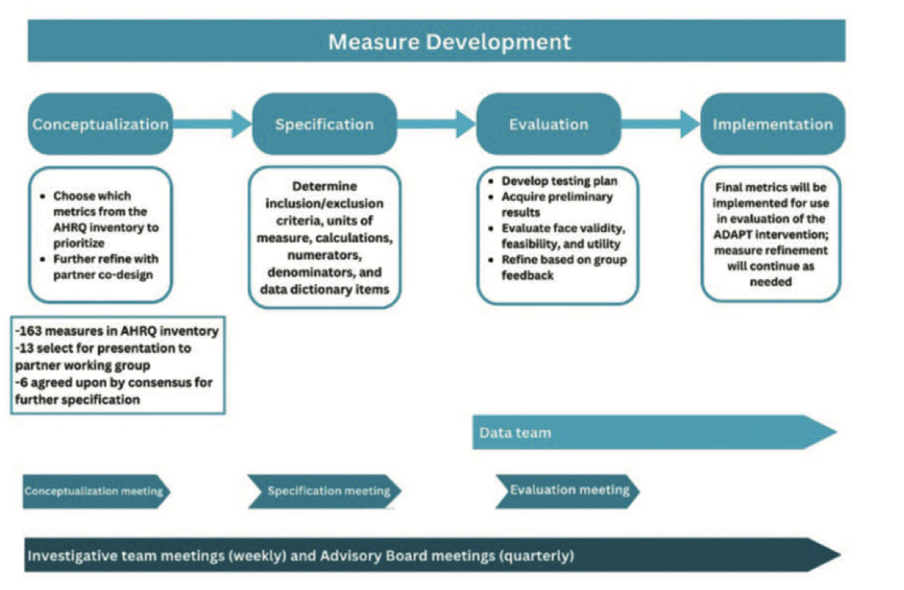

Slide 15
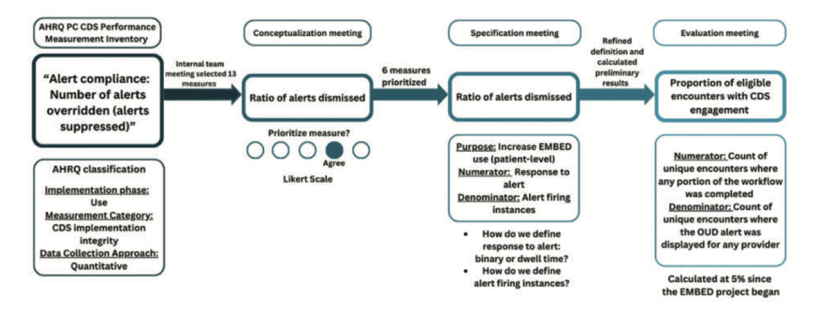

Slide 16
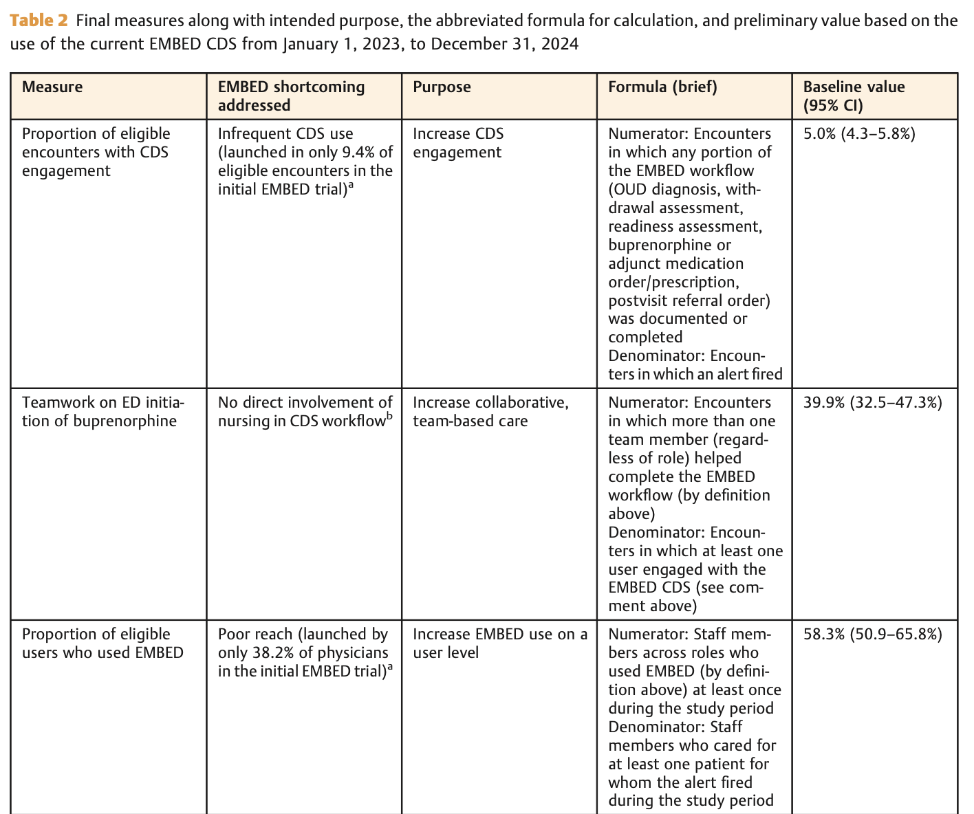

Slide 17
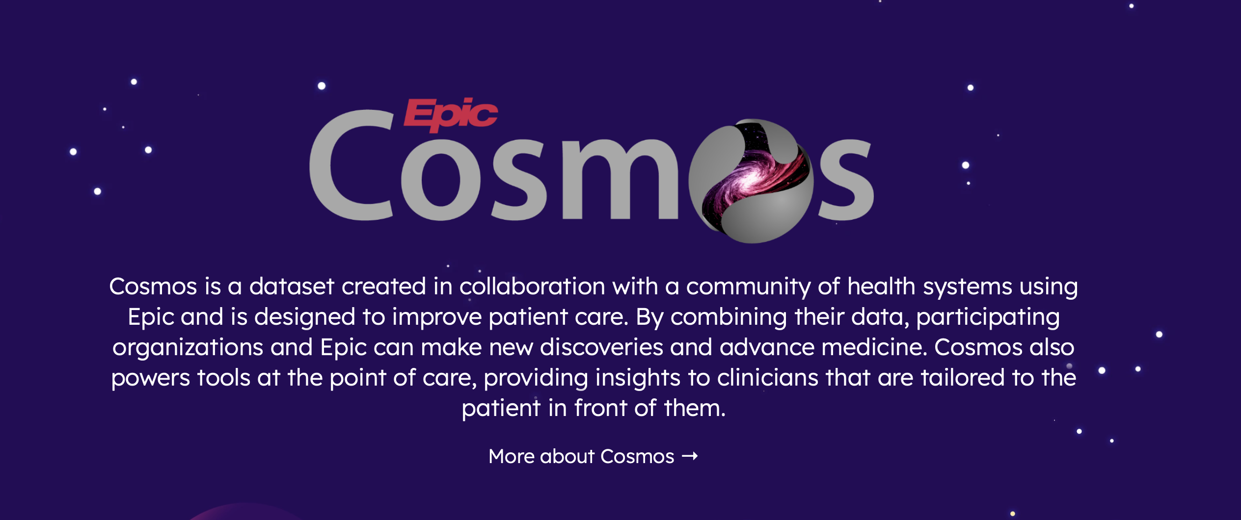

Slide 18
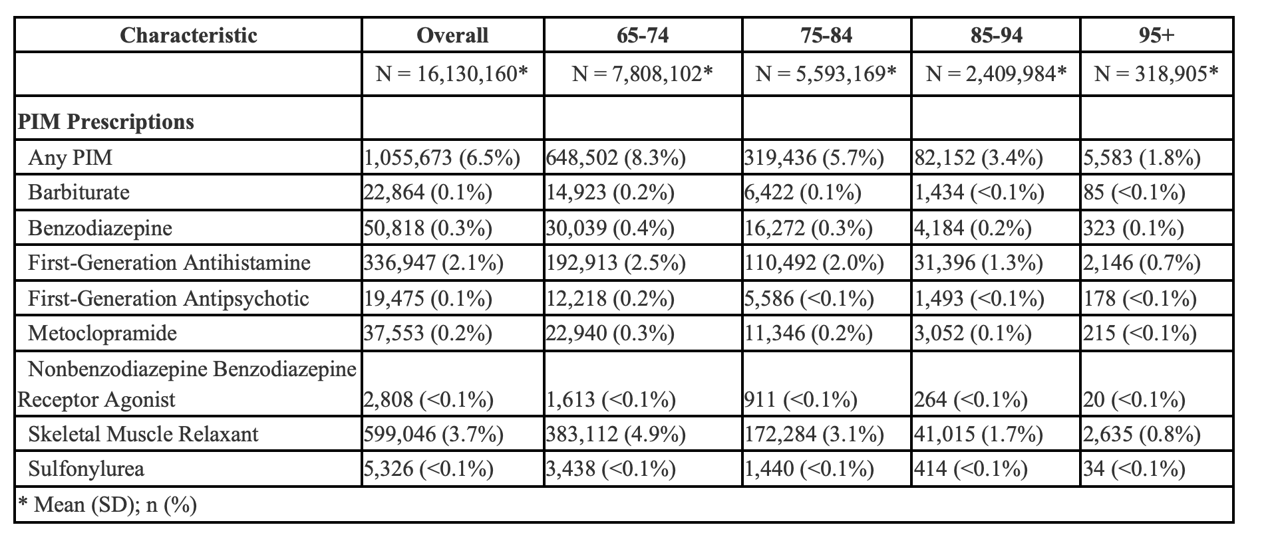
Cosmos: PIM prescriptions in older adults

Slide 19
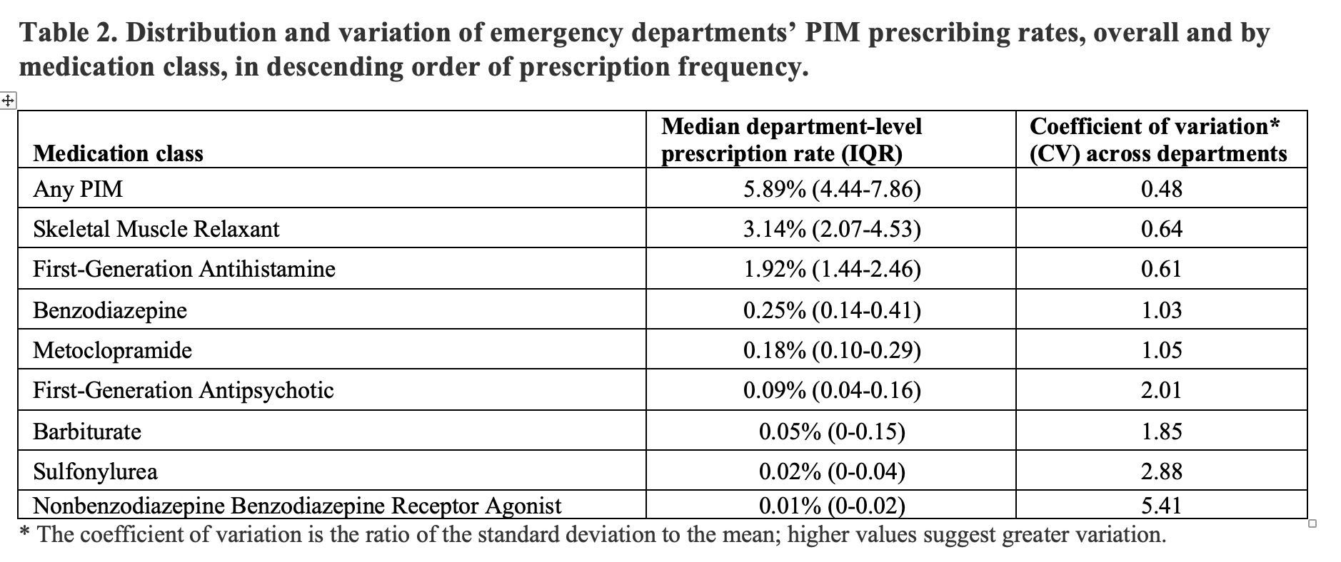
Cosmos: PIM prescriptions in older adults

Slide 20
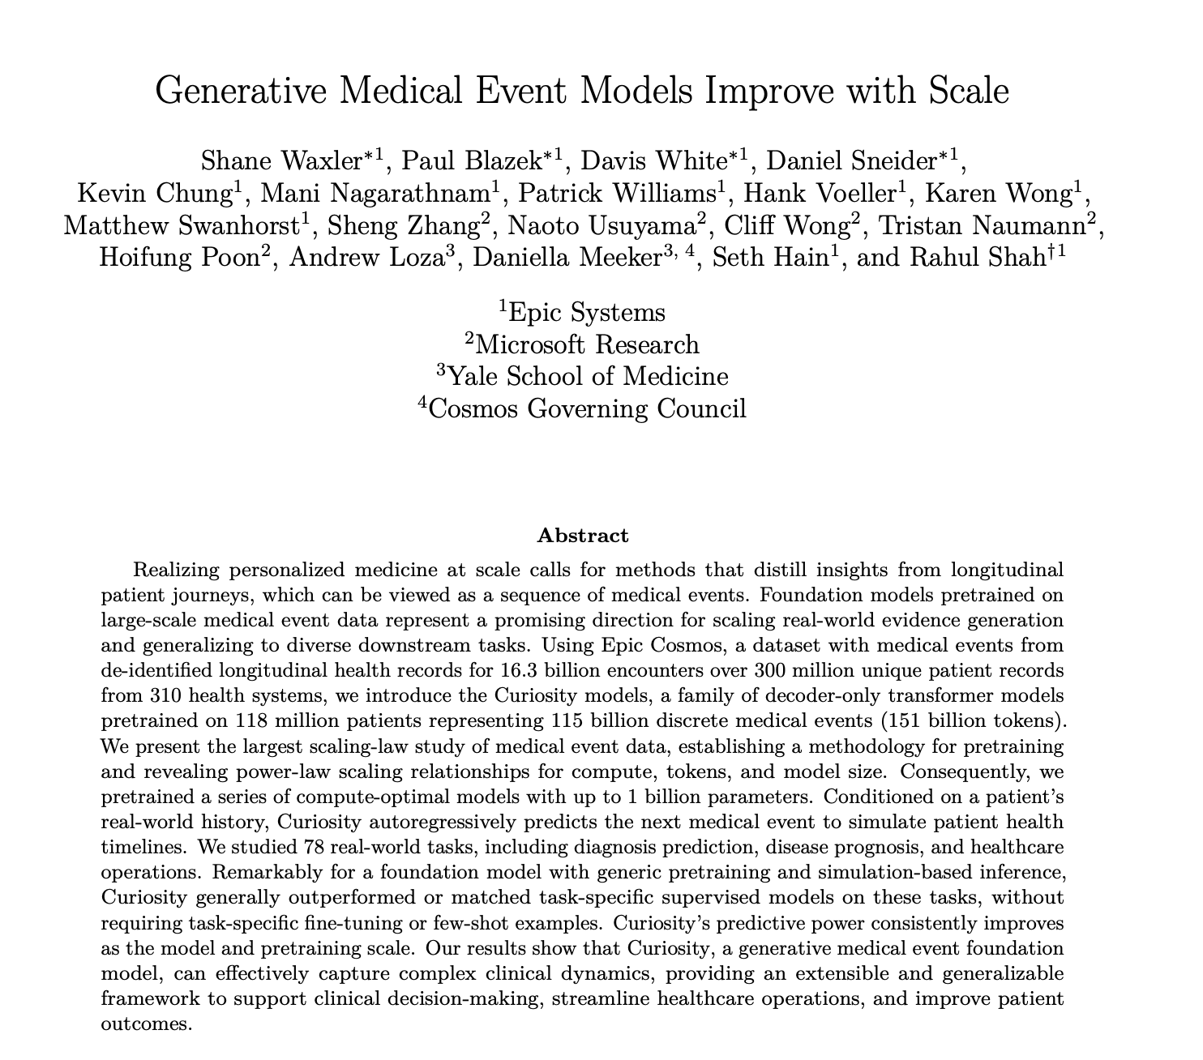

Slide 21
Ongoing projects
Real-time predictive modeling to inform CDS:
Urine culture prediction (YNHH Innovation; Huan Li)
Dementia diagnosis (NIA; Inna Cohen, Emily Johns)
NLP:
Identification of adverse drug reactions in unstructured clinical notes (NCATS KL2; Yuan Gao)
EHR use patterns:
Exploration of ED physicians’ information-gathering in simulated cases (AMA; Varada Khanna)
Epic Cosmos:
Various observational studies related to older adults, medication safety, ED care, and opioid use disorder (Yu Sun, Rie Sakai)
GEAR (Geriatric Emergency Care Applied Research) Network:
Boarding in the ED
Ambient AI and clinical notes:
Analysis of note quality and completeness with and without AI (Chartash)
Collaborators/mentors: Ted Melnick, Daniella Meeker, Andrew Taylor (UVA), Lucila Ohno-Machado, Hua Xu, Qingyu Chen

Slide 22
Lab meetings
Tuesdays, 3-4pm
Virtual (Teams) or in-person
Email me (mark.iscoe@yale.edu) if you’d like to join

